Slide 1


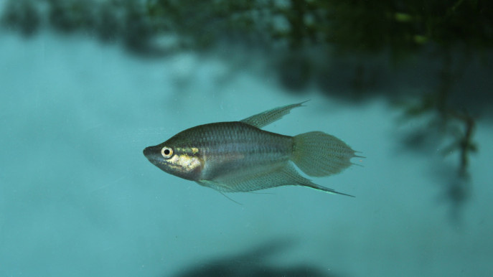

AI-Based Identification of Freshwater Fish Species in Bangladesh Using Image Classification
Tasmia Hossain 20210204038
Abu Dojana 20210204039
Md. Ahnaf Ahsan 20210204048

Slide 2






Overview
Introduction
01
Lightweight CNN Architecture
05
Related Works
02
Result Analysis
06
Dataset
03
Conclusion
07
Methodology
04
2

Slide 3

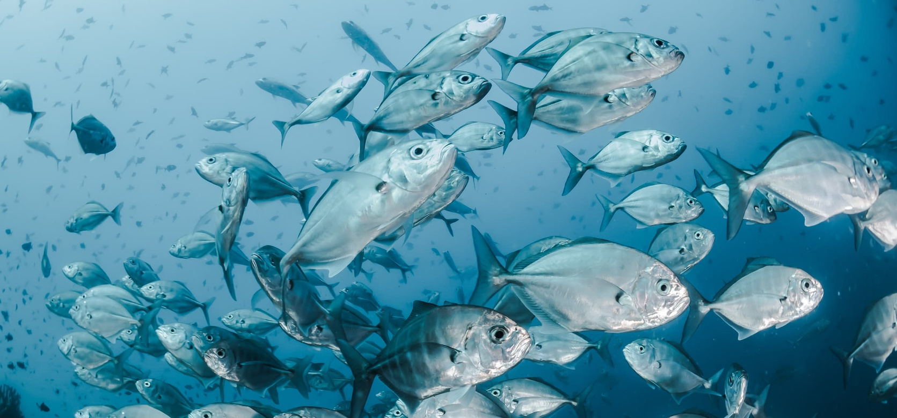

Introduction
  What: Identify freshwater fish species in Bangladesh using AI
  Why: Manual identification is slow, error-prone, and requires experts
  How: Use CNNs & Vision Transformers on a real-world dataset of 12 fish species
  Goal: Build a robust pipeline handling class imbalance, noisy images, and market conditions
3

Slide 4

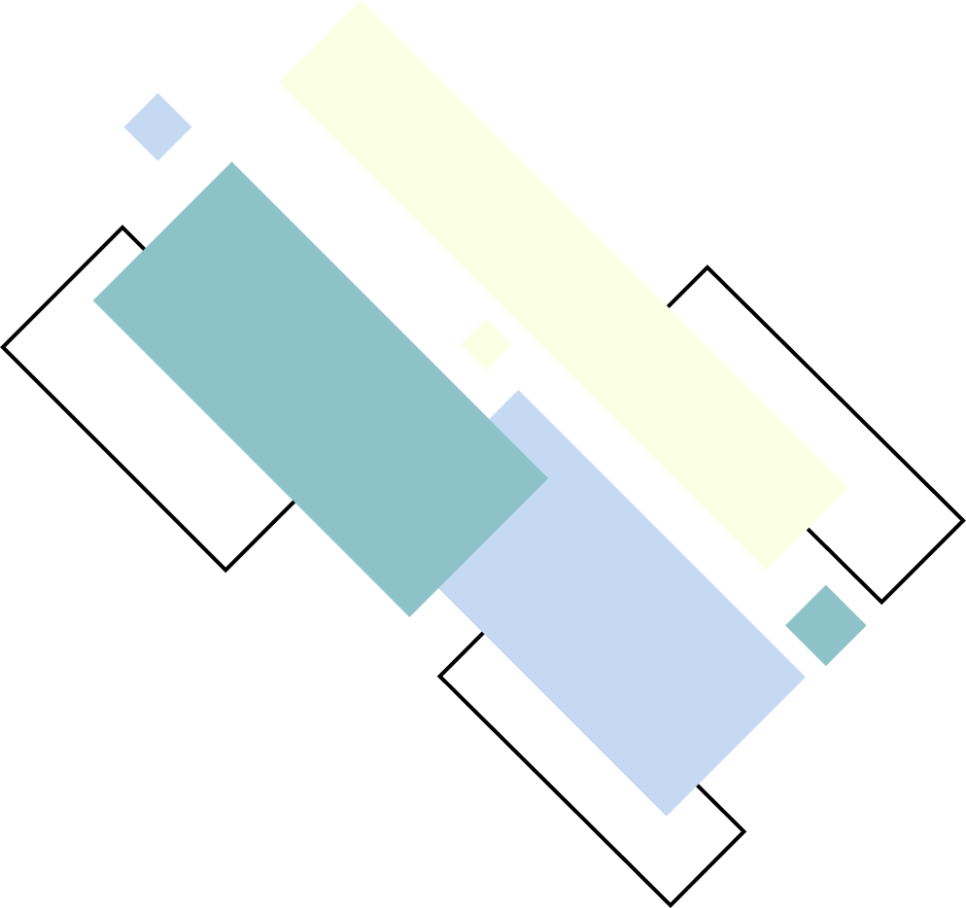


Related Works
  Shaikh et al., 2025: Hybrid CNN (ResNet50 + SVC + Cat Swarm); 98.7% accuracy on 8 species; limited dataset & scalability.
  Miller et al., 2025: PRISMA review of 312 AI-biodiversity studies; highlighted global growth, data limitations, and lack of generalizability.
  Ahmed et al., 2023: IoT-enabled hybrid CNN + ConvLSTM; 97% accuracy; DenseNet strong; dataset limits broader use.
  Wasik & Pattinson, 2024: AI in fish taxonomy & monitoring; emphasized ethics & large-scale ecological applications.
  Das et al., 2024: BD-Freshwater-Fish dataset (4,389 images, 12 species); standardized data; filled regional gap for AI systems.
Motivation: Existing works have limitations in dataset diversity, scalability, and class imbalance
→ Our work addresses these gaps for robust real-world deployment.
4

Slide 5


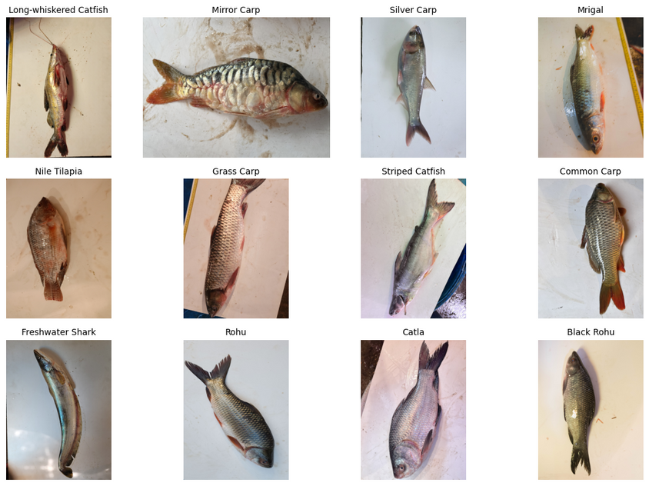
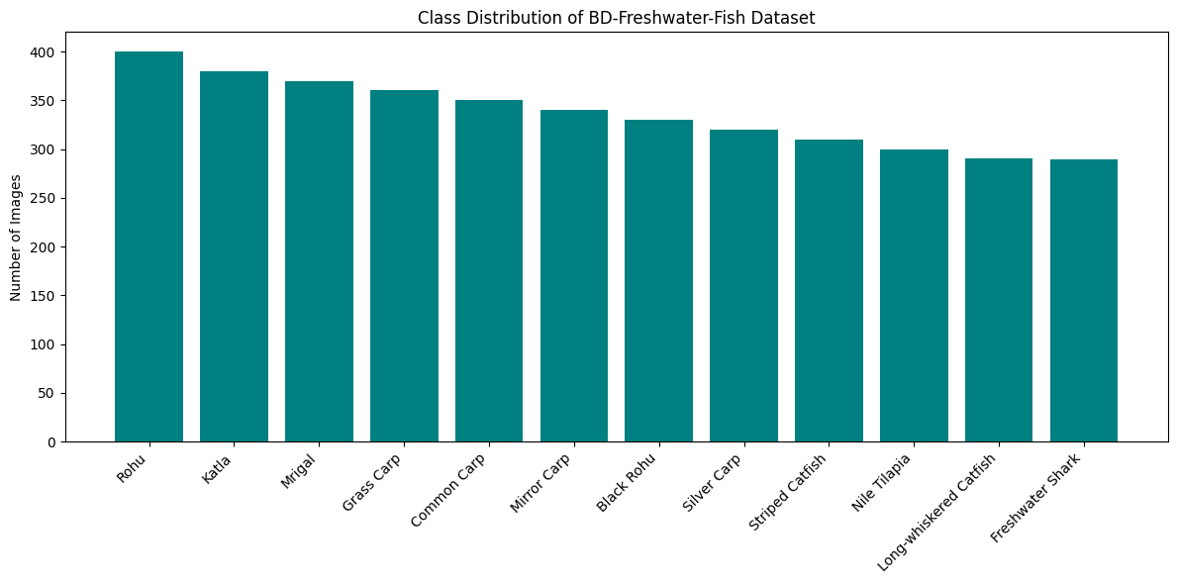
Dataset
BD Freshwater Fish Dataset : https://data.mendeley.com/datasets/2gkj4h388d/3
  Comprises 4,389 high-resolution images.
  Features 12 distinct fish species, ensuring broad classification capability.
  Stratified split: 70% for training, 15% for validation, and 15% for testing to maintain class distribution.
5

Slide 6

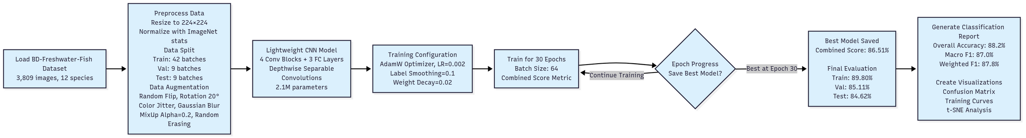
Methodology
6

Slide 7
LIGHTWEIGHT CNN ARCHITECTURE
7

Slide 8

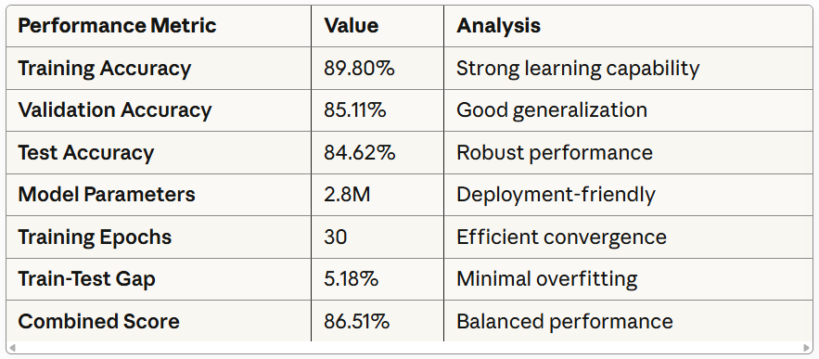
Result Analysis
Table 1: Overall Model Performance
8

Slide 9
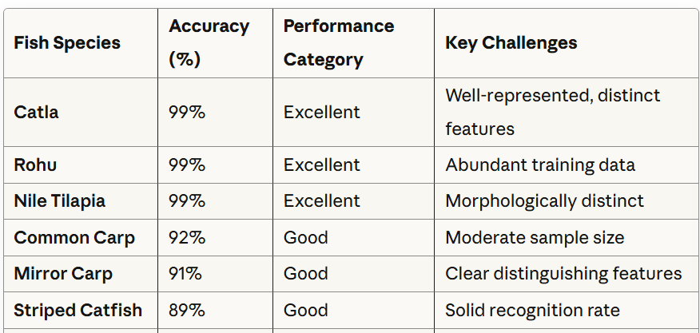
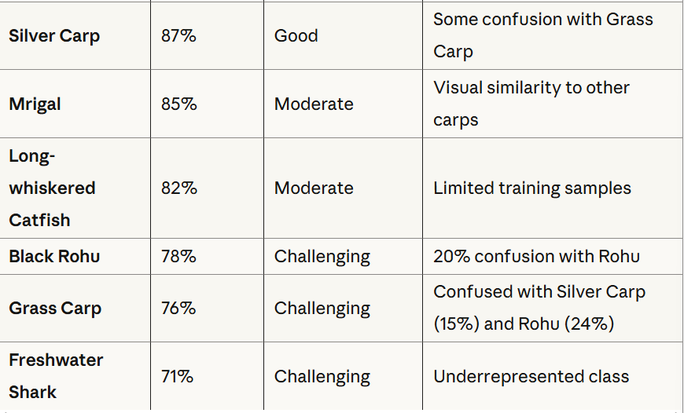
Result Analysis
Table 2: Species-Specific Classification Performance
9

Slide 10

Conclusion
Achievements
  Achieved 84.62% test accuracy with only 2.8M parameters
  Validation accuracy: 85.11% demonstrating good generalization
  Successfully implemented advanced training techniques for enhanced stability
  Demonstrated robust generalization with minimal overfitting on unseen data
  Designed an efficient model suitable for practical deployment scenarios
Future Improvements
  Extend training duration to 75+ epochs for potential further refinement
  Incorporate attention mechanisms to focus on salient image features
  Implement test-time augmentation (TTA) for marginal accuracy gains
  Optimize the model for real-time deployment on edge devices
10

Slide 11


THANK YOU!

